Slide 1

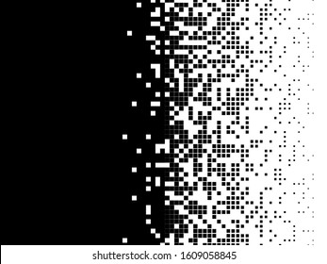
FAKE IMAGE IDENTIFICATION
USING MACHINE LEARNING
SUBMITTED BY
D. Aishwarya(19TP1A0534)
CH. Pragathi(19TP1A0525)
B. Chandu(19TP1A0520)
D. Deekshith(19TP1A0533)
UNDER THE GUIDENCE OF
Dr .S. Krishna Mohan Rao sir

Slide 2
Contents
ABSTRACT
Introduction
About LBP
CNN Algorithm
How CNN works
Existing System
Disadvantages Of Existing System
Proposed System
Advantages of Proposed System

Slide 3
Contents
Software Requirements Specification
Modules
UML Diagrams
Implementation (sample code)
Testcases
Screenshots
Conclusion
Future enchancement
References

Slide 4
Abstract
Nowadays biometric systems are useful in recognizing a person’s identity, but criminals change their appearance in behavior and psychological to deceive recognition system.
To overcome this problem we are using a new technique called Deep Texture Features extraction from images and then building train machine learning model using CNN (Convolution Neural Networks) algorithm.
This technique refers as LBPNet or NLBPNet as this technique is heavily dependent on features extraction using LBP (Local Binary Pattern) algorithm.
In this project, we are designing LBP Based machine learning Convolution Neural Network called LBPNET to detect fake face images. Here first we will extract LBP from images and then train LBP descriptor images with Convolution Neural Network to generate a training model.
Whenever we upload a new test image then that test image will be applied to the training model to detect whether the test image contains a fake image or a non-fake image. Below we can see some details on LBP

Slide 5
introduction
Local binary patterns (LBP) could be a variety of visual descriptors used for classification in laptop vision and could be an easy nonetheless terribly economical texture operator that labels the constituents of a picture by thresholding the neighbourhood of every pixel and considers the result as a binary variety.
Because of its discriminative power and machine simplicity, the LBP texture operator has become a preferred approach in numerous applications.
It is often seen as a unifying approach to the historically divergent applied mathematics and structural models of texture analysis.

Slide 6
Lets know about lbp
Local Binary Patterns (LBP) is a texture descriptor used in computer vision to describe the texture of an image.
It compares each pixel in an image to its surrounding pixels and encodes the results in a binary pattern.
These binary patterns can then be used to classify the texture of the image, or to compare the texture of different images.
LBP is often used in applications such as object recognition and face recognition, because it is robust to changes in lighting and can be computed quickly.

Slide 7
What is Cnn algorithm
convolutional neural network (CNN or convnet) is a subset of machine learning. It is one of the various types of artificial neural networks which are used for different applications and data types. A CNN is a kind of network architecture for deep learning algorithms and is specifically used for image recognition and tasks that involve the processing of pixel data.
There are other types of neural networks in deep learning, but for identifying and recognizing objects, CNNs are the network architecture of choice. This makes them highly suitable for computer vision (CV) tasks and for applications where object recognition is vital, such as self-driving cars and facial recognition.

Slide 8
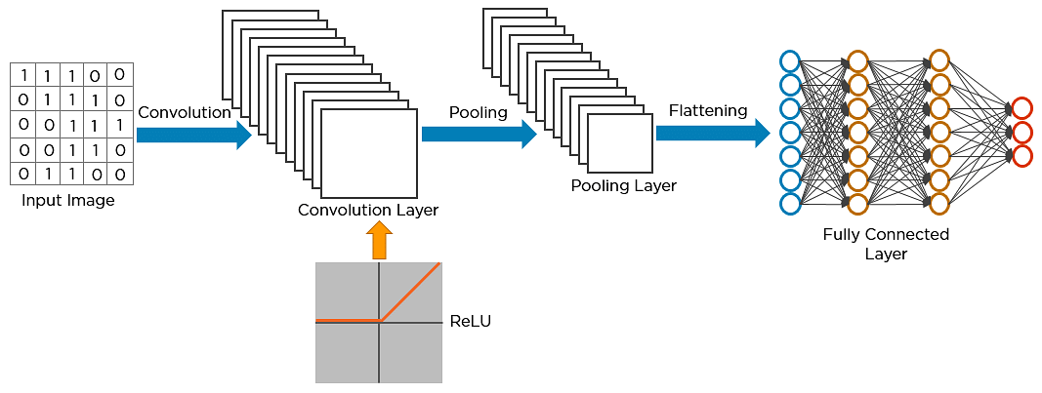
How does CNN works
CNN utilizes spatial correlations which exist with the input data. Each concurrent layer of the neural network connects some input neurons. This region is called a local receptive field. The local receptive field focuses on hidden neurons.

Slide 9
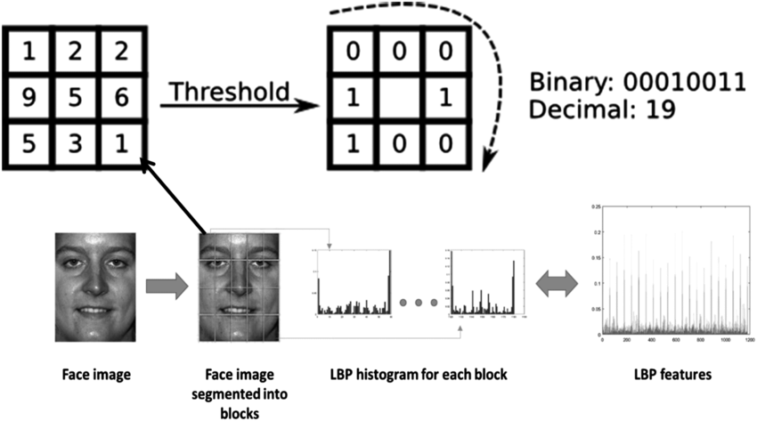

Slide 10
Existing system
When capturing an image, additional required hidden information is associated with it for authentication and forgery protection purposes.
The passive technique does not rely on extra information, but it analyzes some features extracted from the digital content of the image itself.
Copy-move means coping a part of an image and pasting it into another place of the same picture whereas splicing is about taking a part of an image and pasting it into another.

Slide 11
Disadvantages of existing system
⮚ Complexity in analyzing the data
⮚ Prediction is a challenging task working in the model
⮚ Coding is complex maintaining multiple methods.
⮚ Library's support was not that much familiar.

Slide 12
Proposed system
In this project, we have a tendency to area unit planning LBP primarily based machine learning Convolution Neural Network known as LBPNET to sight pretend face pictures.
Here 1st we'll extract LBP from pictures and so train LBP descriptor pictures with Convolution Neural Network to get coaching model.
Whenever we have a tendency to transfer a new image then that image is going to be applied on coaching model to sight whether or not take a image contains pretend image or non-fake image.

Slide 13
Advantages of proposed system
⮚ Libraries help to analyze the data
⮚ Statistical and prediction is very easy compared to existing technologies
⮚ Results will be accurate compared to other methodologies.

Slide 14
Software system requirements :
I. SOFTWARE REQUIREMENTS:
II. HARDWARE REQUIREMENTS:
Operating system : Windows 10
Coding Language : Python
Tool : PyCharm
System : Pentium IV 2.4 GHz.
Hard Disk : 40 GB.
Ram : 512 Mb.

Slide 15
Modules
There are several modules that can be used for identifying fake images using machine learning:
Preprocessing: This module is responsible for cleaning and preparing the raw data for use by the model.
Feature extraction: This module is responsible for extracting useful features from the images that can be used to identify fake images.
Model training: This involves training a machine learning model on the prepared dataset, using an algorithm such as a convolutional neural network (CNN).
Evaluation: This module is responsible for evaluating the performance of the model and determining how well it is able to detect fake images.
Deployment: This involves deploying the trained model in a production environment, where it can be used to identify fake images in real-time.

Slide 16
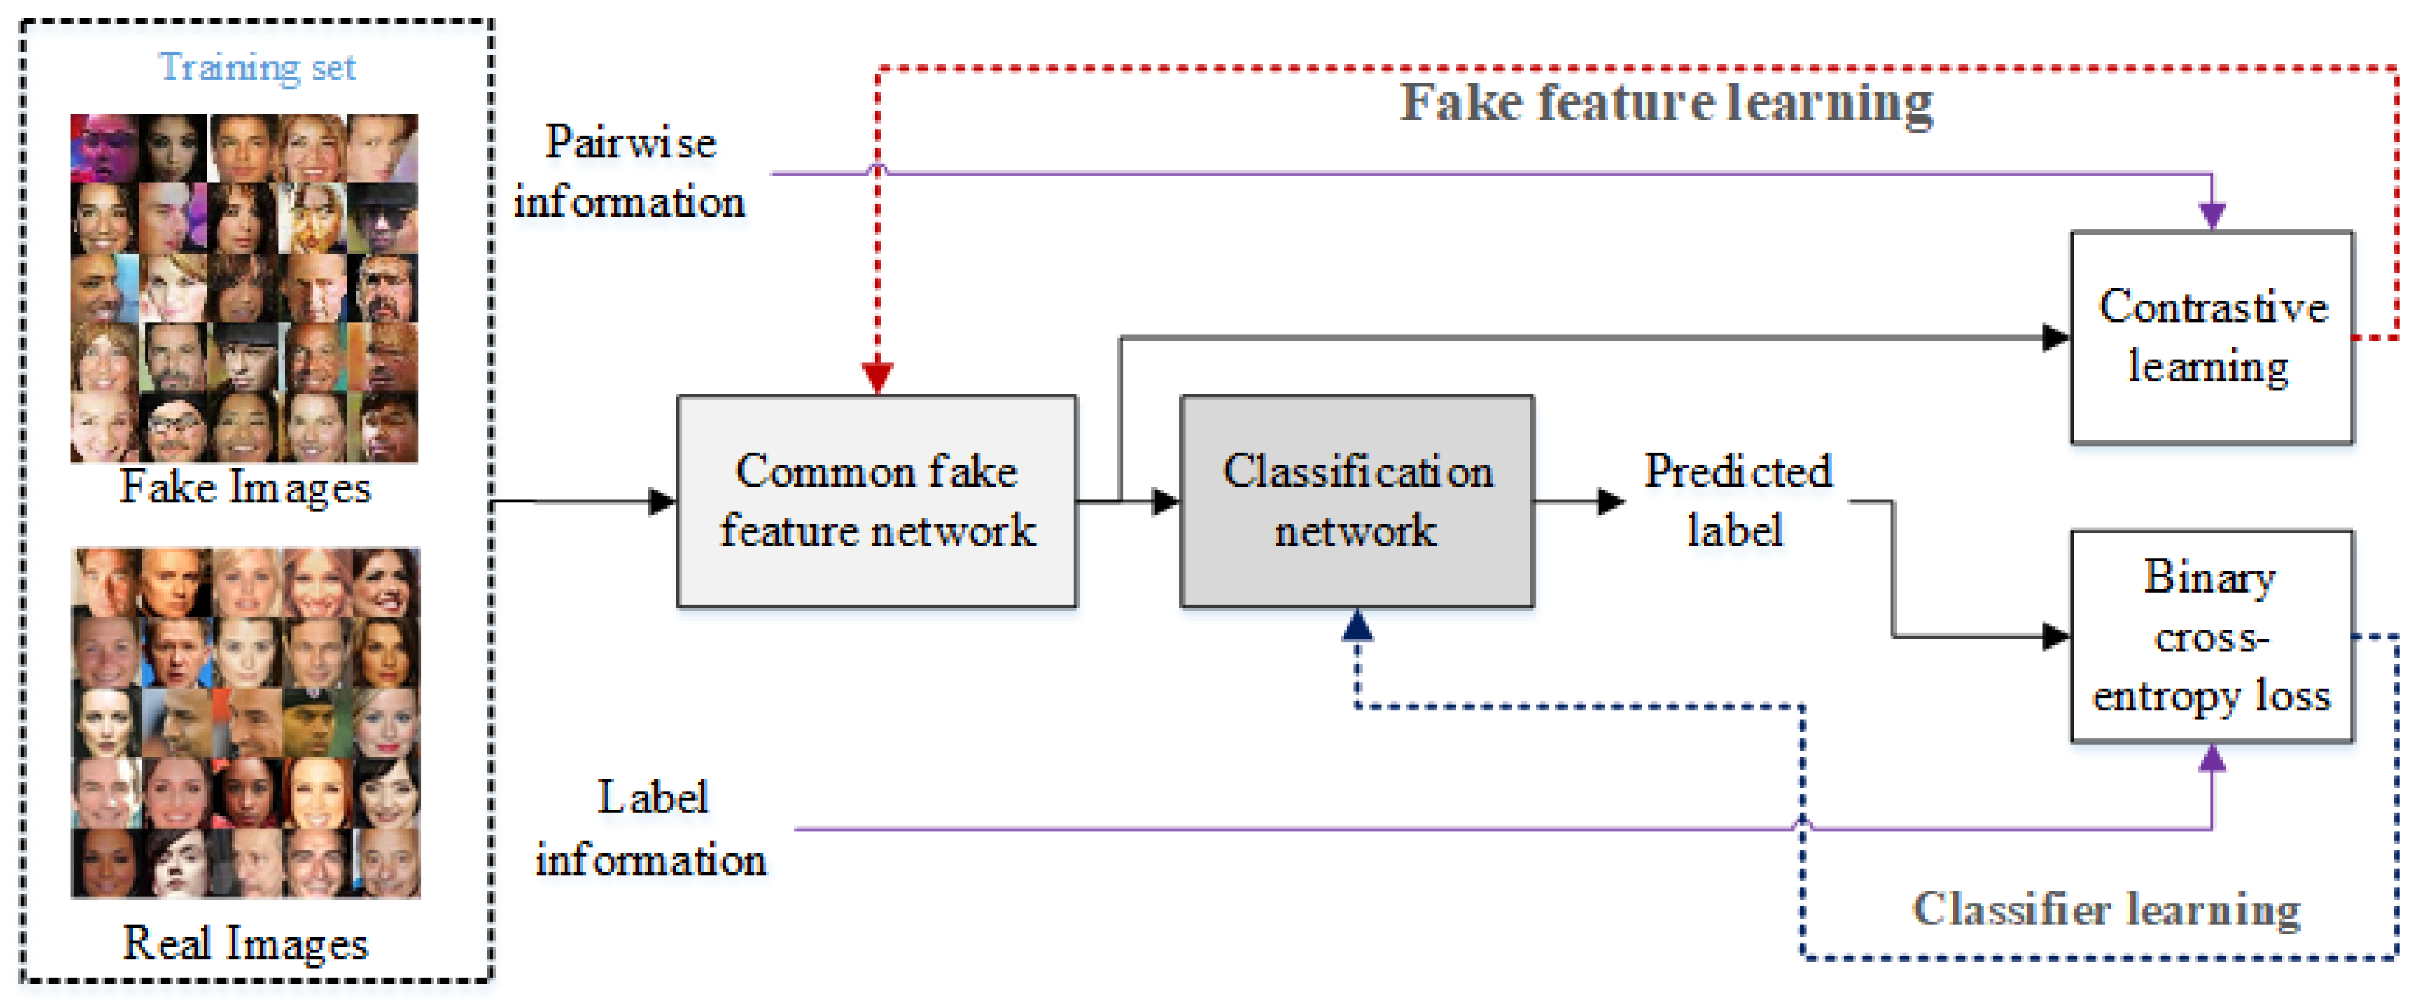
Uml Diagrams

Slide 17
Use case diagram

Slide 18
Class diagram

Slide 19
Sequential diagram

Slide 20
Flow chart

Slide 21
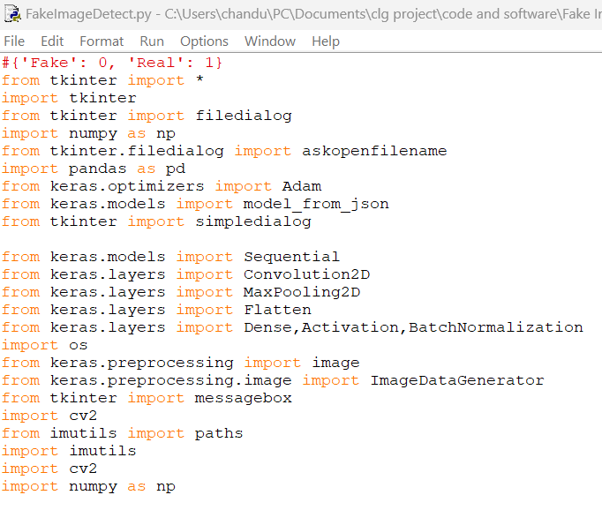
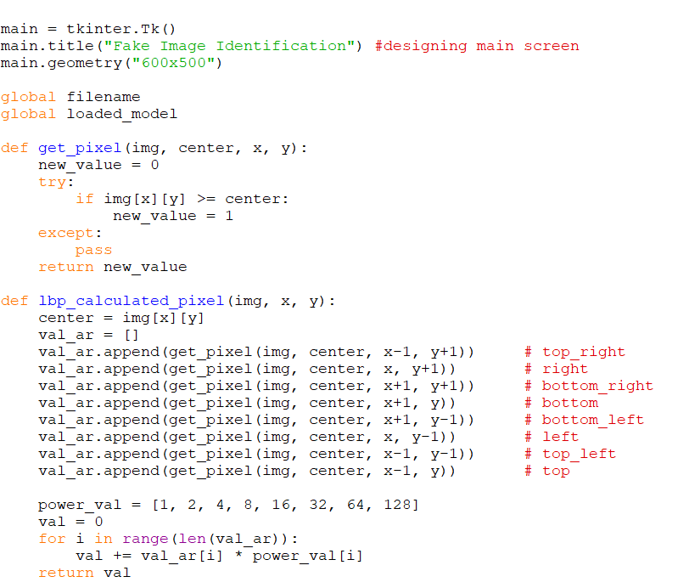
Sample code

Slide 22
Test cases
s.no | Summary | Field | Inputtype | Example | Expectedresult | Actualresult | Status
1 | expression | expression | Image1 | happy | Accepted | Accepted | Pass
2 | expression | expression | Image2 | sad | Accepted | Accepted | Pass
3 | expression | expression | Image3 | nuetral | Accepted | Accepted | Pass
4 | expression | expression | Image4 | fearful | Accepted | Accepted | pass
5 | expression | expression | Image5 | angry | Accepted | Accepted | Pass
6 | expression | expression | Image6 | disgusted | Accepted | Accepted | Pass
7 | expression | expression | Image7 | surprised | Accepted | Accepted | Pass

Slide 23
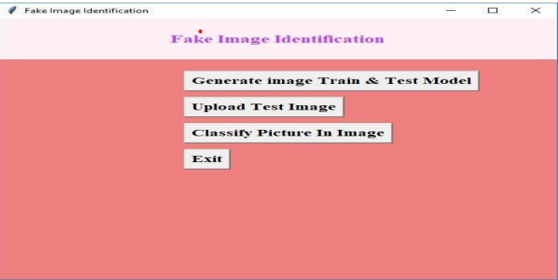
Screen shots
Output screen 1

Slide 24
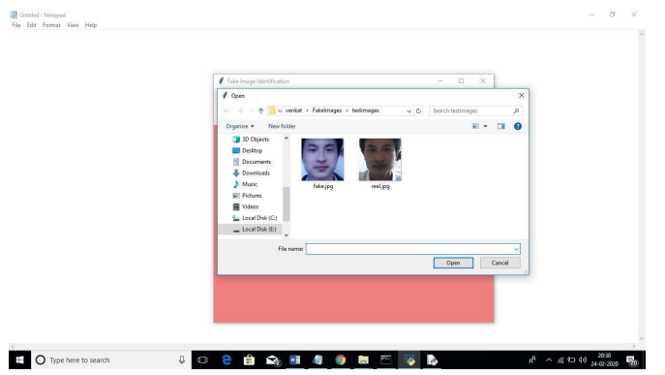
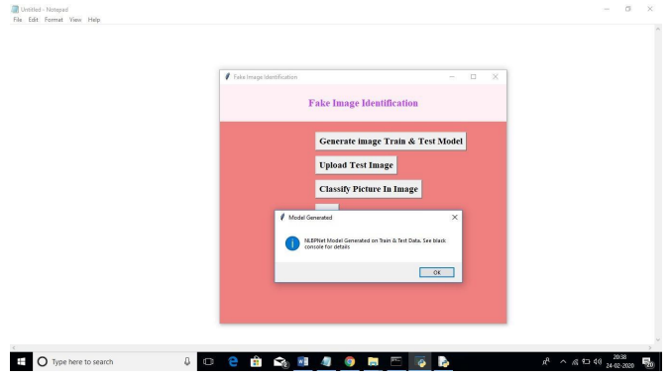
Output screen 2 output screen 3

Slide 25
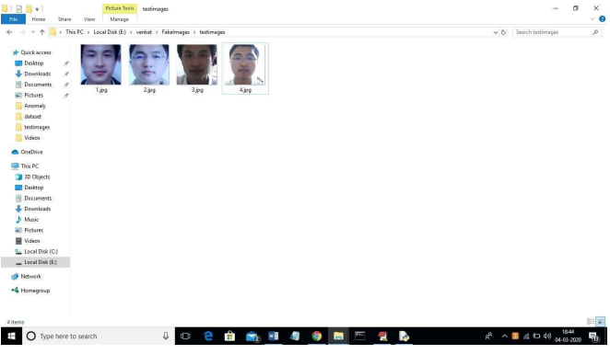
Output screen 4

Slide 26
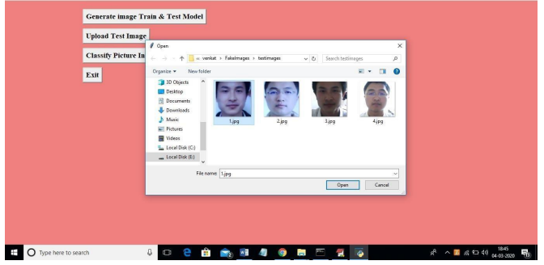
0utput screen 5

Slide 27
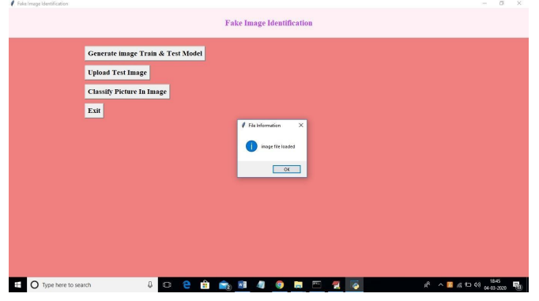
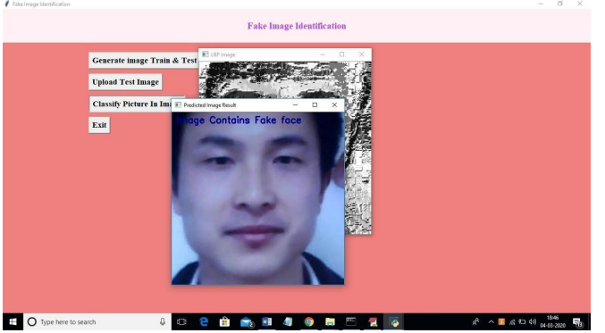
Output screen 6 output screen 7

Slide 28
Conclusion and future enhancement
In this study, we have proposed a novel common fake feature network-based pairwise learning, to detect the fake face/general images generated by state-of-the-art GANs successfully. The proposed CFFN can be used to learn the middle- and high-level and discriminative fake features by aggregating the cross-layer feature representations into the last fully connected layers.
The proposed pairwise learning can be used to improve the performance of fake image detection further. With the proposed pairwise learning, the proposed fake image detector should be able to have the ability to identify the fake image generated by a new GAN. Our experimental results demonstrated that the proposed method outperforms other state-of-the-art schemes in terms of precision and recall rate.
For future, work square measure for instance employing an additional complicated and deeper model for unpredictable issues. Integration of deep neural networks with the idea of increased learning, wherever the model is simpler. Neural network solutions seldom take under consideration non-linear feature interactions and non-monotonous short-run serial patterns, that square measure necessary to model user behavior in thin sequence information.
A model is also integrated with neural networks to unravel this downside. The dataset can be inflated and another variety of images can be used for coaching, for instance, gray-scale pictures

Slide 29
references
[1]. G.Mohamed Sikandar, "100 Social Media Statistics You must know," [online] Available at:https://blog.statusbrew.com/social-mediastatistics-2018-for-business/ [Accessed 02 Mar 2019].
[2]. Damian Radcliffe, Amanda Lam, "Social Media in theMiddlEast,"[online]Available:https://www.researchgate.net/publication/32318 5146_Social_Media_in_the_Middle_East_The_Story_of_2017 [Accessed 06 Feb 2019]. [3]. GMI_BLOGGER,"Saudi Arabia Social Media Statistics," GMI_ blogger. [online] Available at:https://www.globalmediainsight.com/ blog/saudi-arabia-social-media-statistics/ [Accessed 04 May 2019].

Slide 30
Thank You

